Slide 1
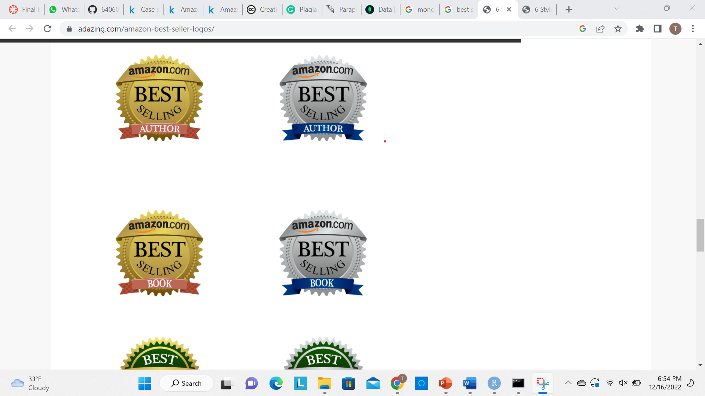

FUNDAMENTALS OF MACHINE LEARNING (MIS-64060-003)
Analysis of Amazon’s best book-sellers through
the 10-year period (2012-2022)
Presented by: Tejaswini Yeruva

Slide 2

Objective/Problem
It is challenging to derive conclusions from the raw data and compare them over time in this study because statistics on the best-selling books over the previous 10 years are gathered annually.
The goal of this study is to use the collected data to cluster the population of best-selling books and make it easier to recognize these clusters and features from the data, allowing for more effective insight as we sample these best-selling books in the future. Price, the number of reviews or readings, popular genres, and so forth are examples of such features.

Slide 3
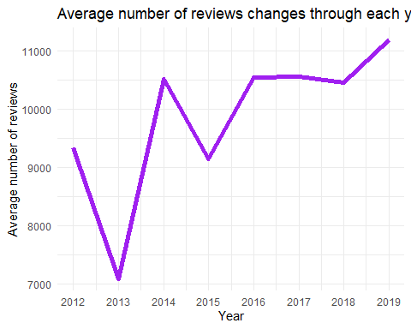
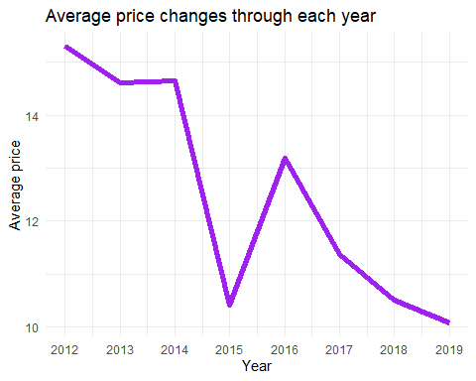
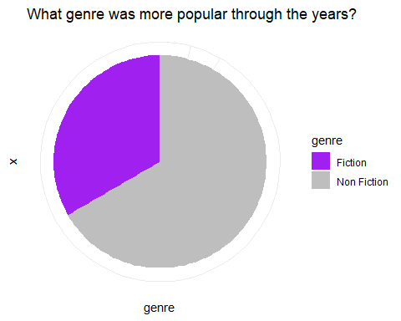
Data Analysis/Approach
Data Analysis
Our approach to this problem is to create a clustering algorithm that will make it easier to organize data and visualize the clusters and characteristics of the booksellers.
Transforming Data, Visualizing, and Analyzing.
Creating the variables for year-specific average values of price, rating, and number of reviews would display the median number of reviews, the mean price, and the mean rating of each year.
(Plots) to visualize the characteristics of the booksellers
With this method, plotting scientific data is done to show correlations between variables or to visualize variation.

Slide 4


conclusion
Based on the Analysis below are the conclusions:
1. Non-fiction books are preferred by readers over fiction novels.
2. In 2020, there were significantly more reviews compared to readings.
3. Until 2020, book prices were steadily declining. We can predict book prices to rise starting in 2020.
The COVID-19 pandemic, which began in 2020, may be related to the second and third clauses.

